Slide 1
Final Presentation Text Mining – Team 4
Ahmed Ashraf Sadek, Amanda Long, Zawaad Shah

Slide 2



topic
Text Mining and analysis of Employee Reviews for FAANG companies.

Slide 3
Final presentation tasks
Perform analysis and draw conclusions based on our findings.
Complete final report.

Slide 4
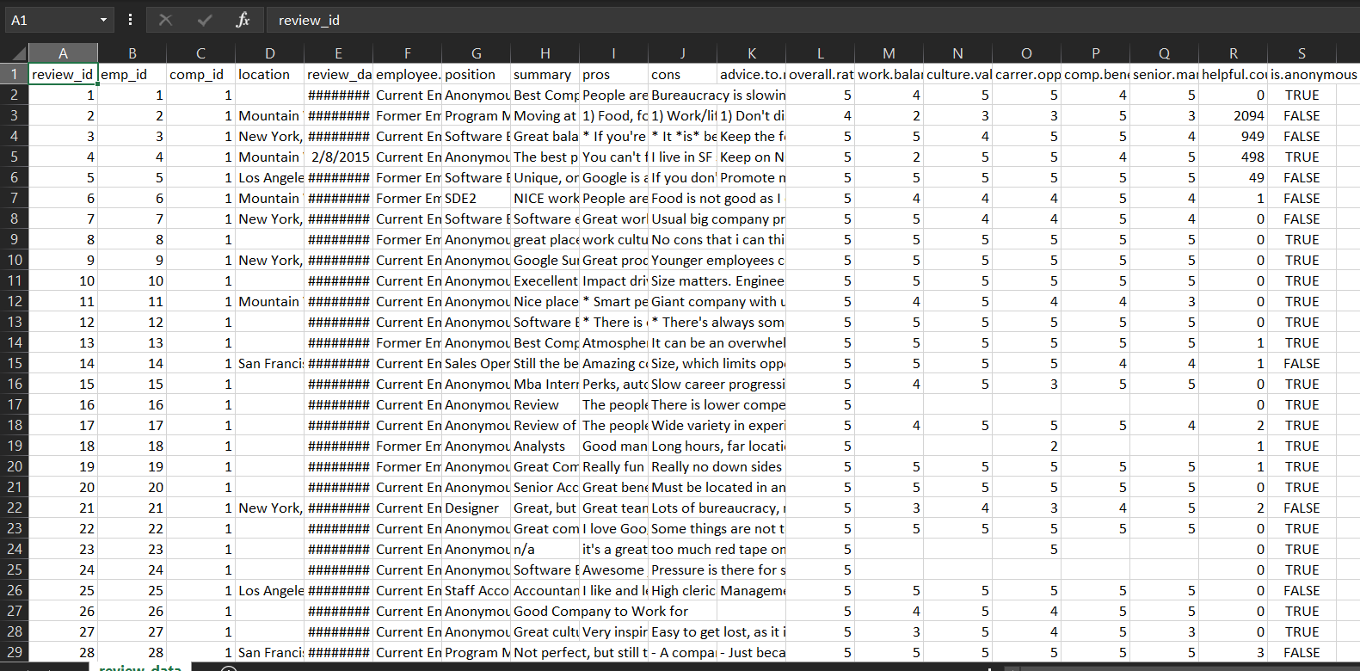
The database
We needed to decide on a reliable source for FAANG employee reviews. There were multiple options available online and each one of them had different sources. The repository we finally decided on was built by scraping the GlassDoor website since its inception in 2008. It was built in 2018, and it is the main source of reviews we are using.

Slide 5
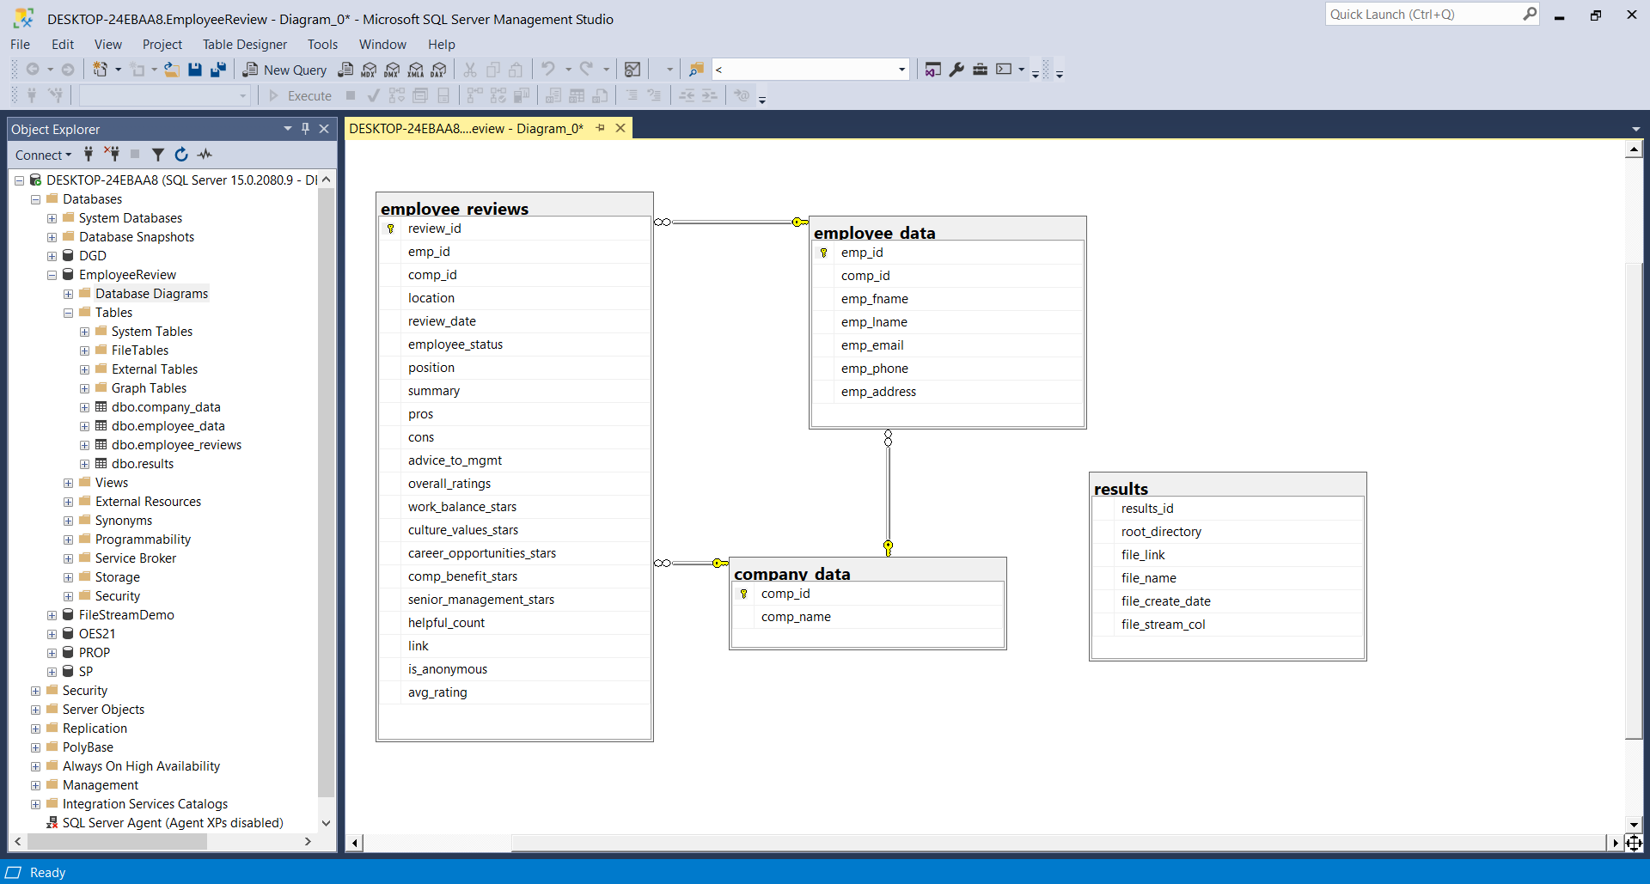
THE DBMS
We decided on SQL Server since it is a reliable RDBMS and has a lot of support for integration with different platforms (such as Power BI) and services (such as Python’s SQLAlchemy).

Slide 6
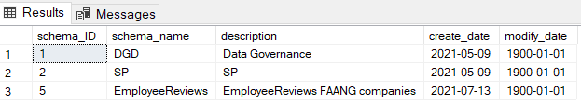
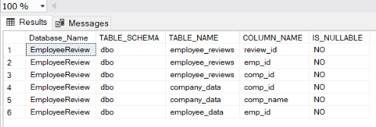
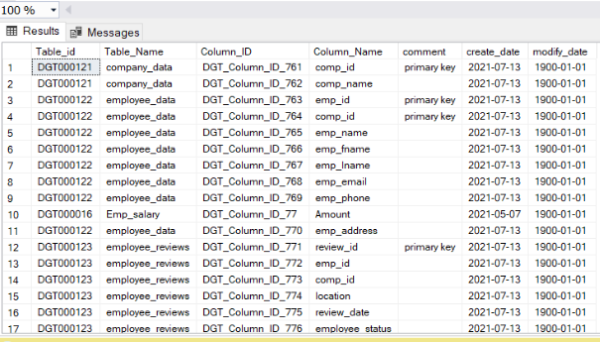
Data governance comparison
Columns, tables and schema

Slide 7

Power BI Demo

Slide 8
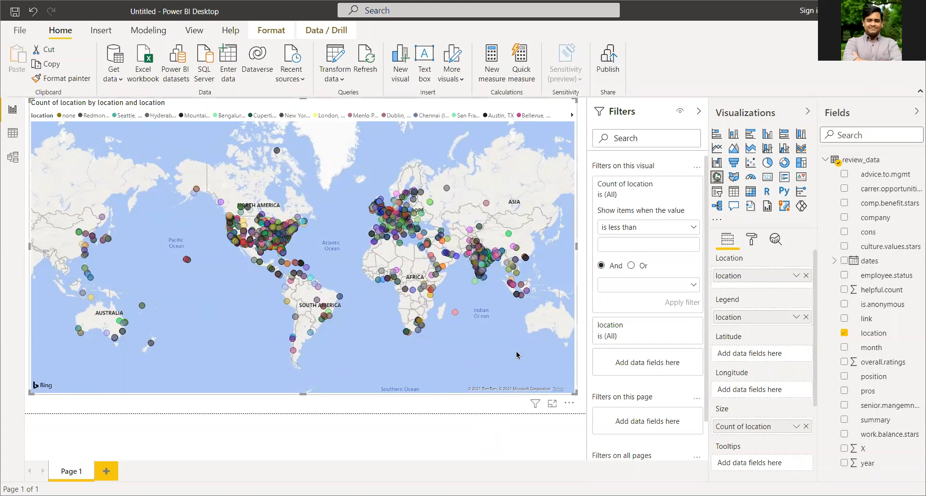

Slide 9
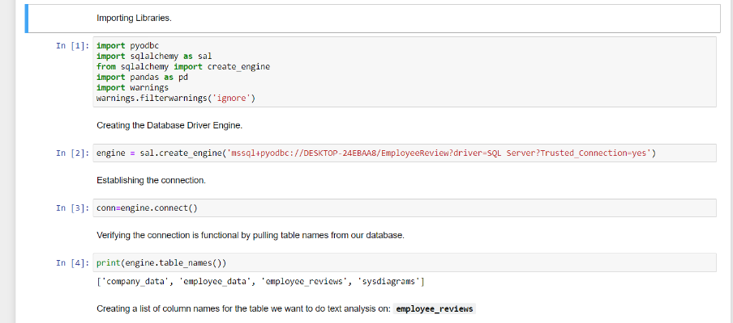
Connecting Python to MSSQL

Slide 10
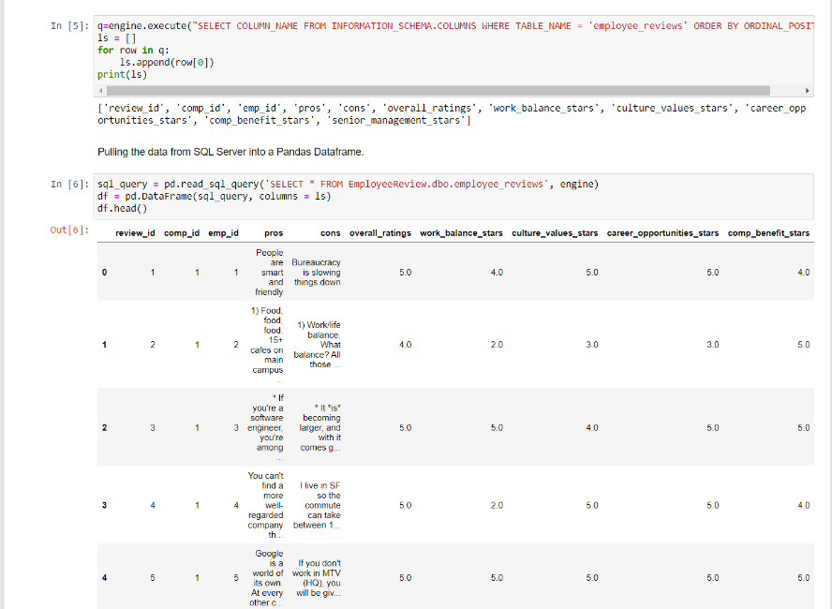

Slide 11




Data analysis tools
We decided to use a combination of both Python (SpaCy for text analysis) and Power. This meant that we needed to learn how to use additional Python libraries such as Pandas for handling dataframes, Numpy for numerical analysis, SciKit-Learn for machine learning and text classification, WordCloud for word cloud visualizations and SQLAlchemy to connect to our DBMS.

Slide 12
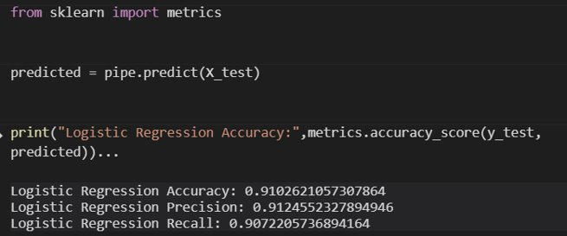
Classification model results

Slide 13
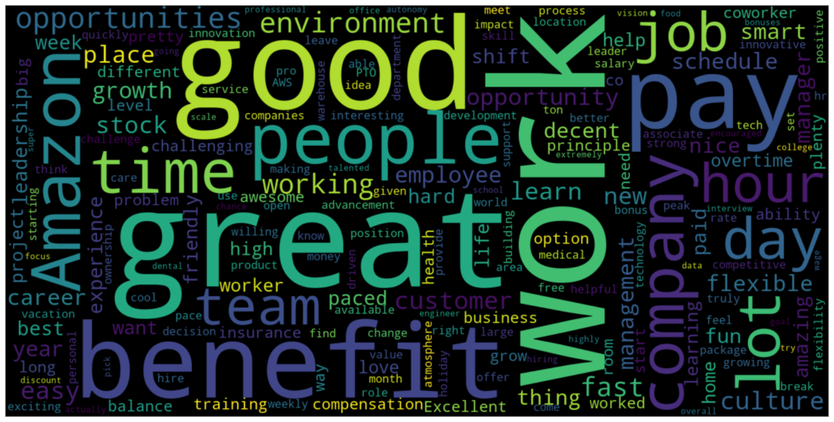
Findings & data visualizations
Amazon pros

Slide 14
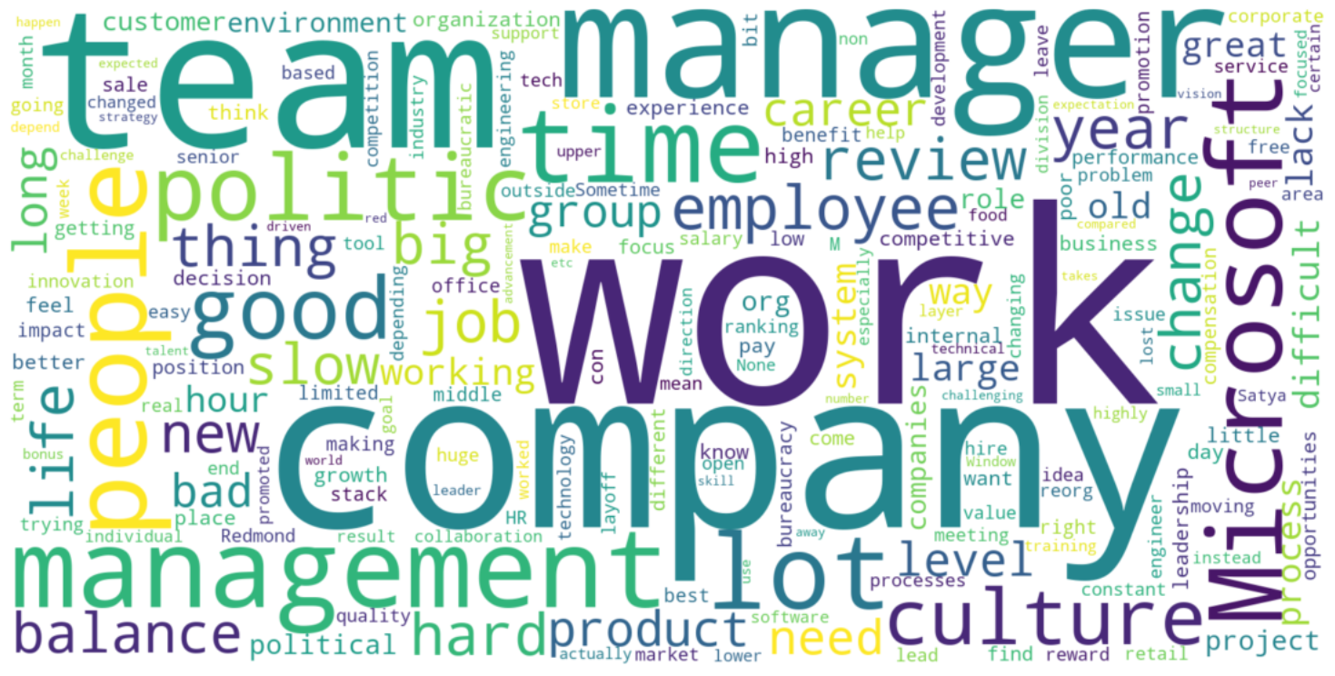
Microsoft cons

Slide 15
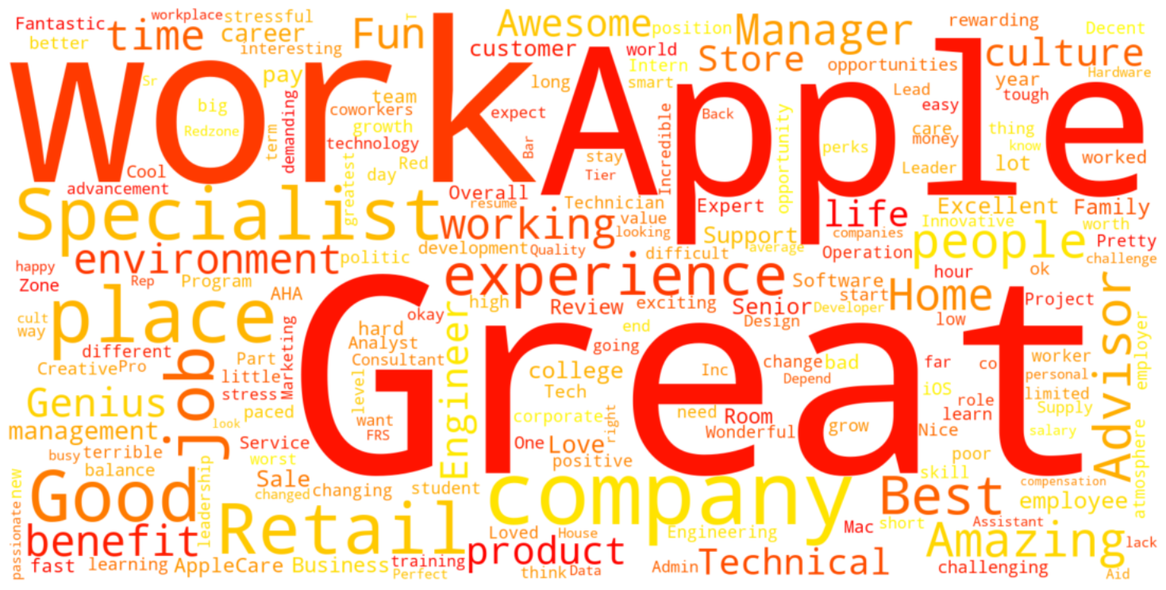
Apple summary

Slide 16
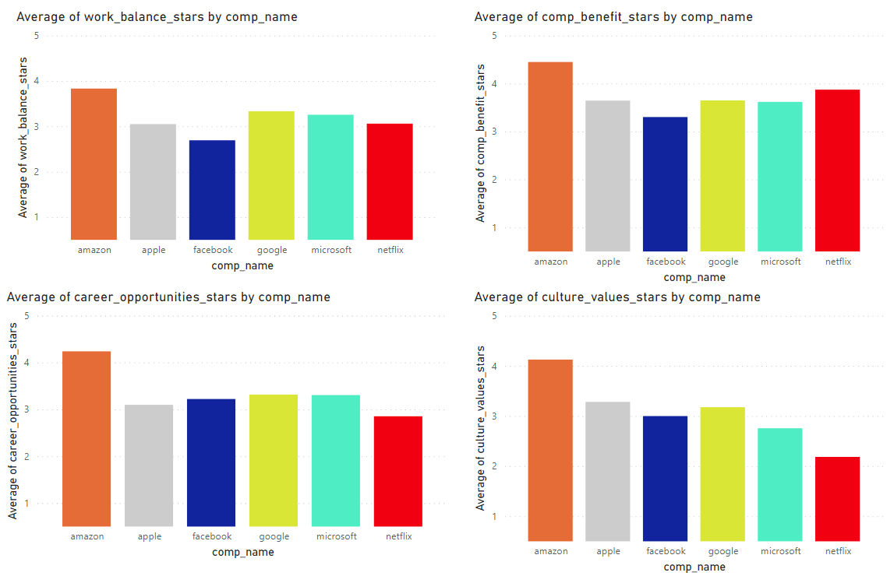
Comparison of different rating categories by company

Slide 17
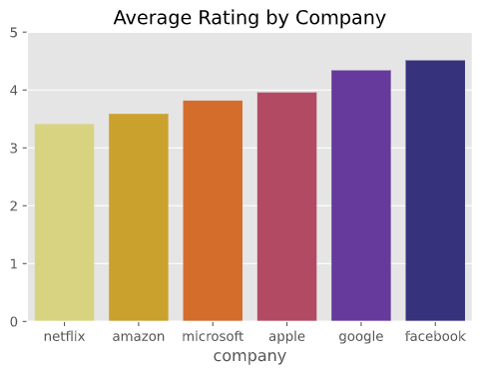
Company ratings

Slide 18
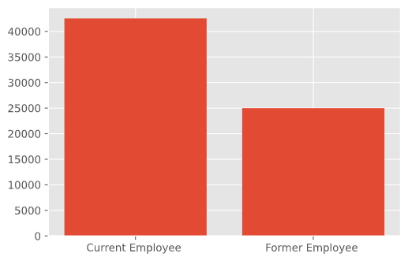
Count of Current vs Former Employee Reviews

Slide 19
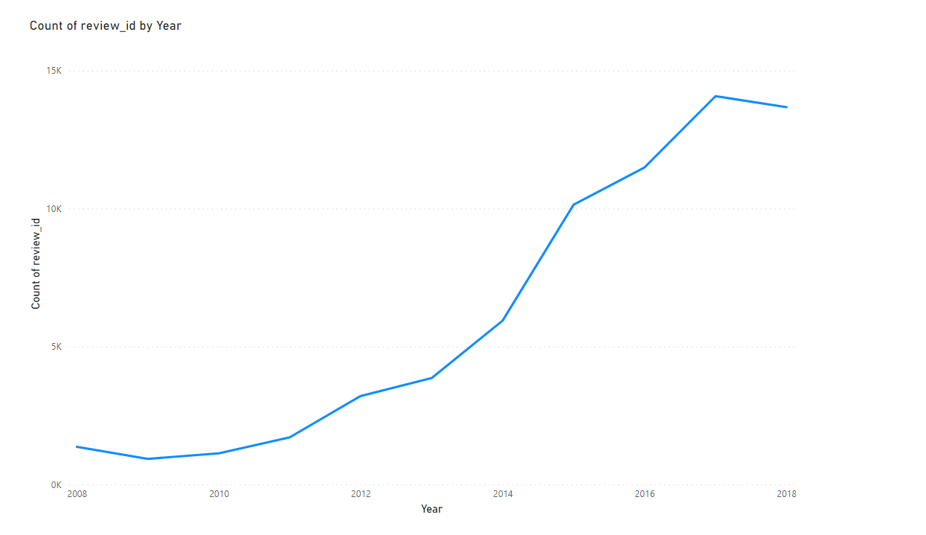
Power BI – Trend of Reviews by year

Slide 20
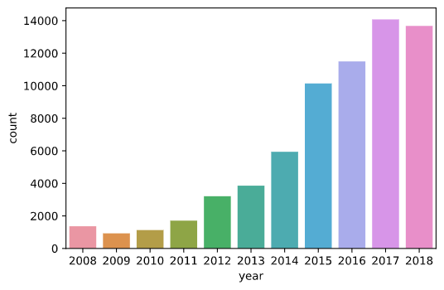
Number of Reviews by year

Slide 21
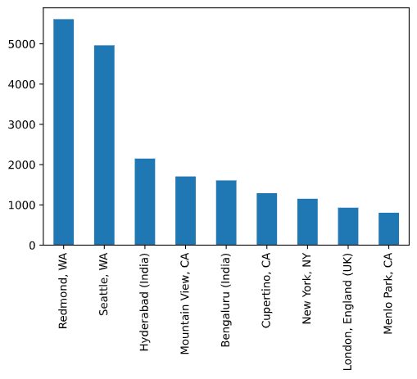
Top Review locations

Slide 22
Project Outcomes
Successfully built a database capable of ingesting more reviews in the future while holding historical data of employees, companies and reviews.
Successfully analyzed textual data of employee reviews to discover the most prominent features that are unique to each company.
Created a pipeline of analysis between SQL Server, Power BI, and Python.
Discovered the main geographical sources of reviews by utilizing Power BI.
Built a text classification model to predict whether a review is positive or negative with a high accuracy (~%90).

Slide 23
Thank you ☺

